Slide 1


Analog Electronic Circuits (UEC301)
By
Dr.Mayank Kumar Rai
Associate Professor,
ECED,TIET,Patiala

Slide 2

Subject: Analog Electronic Circuits (UEC301)
Faculty names: (1) Dr. Mayank Kumar Rai ( Associate Professor & Course Coordinator)
(2) Dr. Arun Chatterjee(Assistant Professor)
(3) Dr. Subiman Chatterjee(Assistant Professor)
Topic of today’s Lecture : Multivibrator-I
Key points
Contents of this lecture are based on the following books:
Switching Action of a BJT
Multivibrator
Types of Multivibrator
Astable (Free running) Multivibrator
Monostable Multivibrator
Bi-stable Multivibrator
Jacob Milman & and C.C.Halkias, “Integrated Electronics Analog and Digital Circuit and Systems”Second Edition.
Adel S. Sedra & K. C. Smith, “MicroElectronic Circuits Theory and Application” Fifth Edition.
Robert L. Boylestad & L. Nashelsky, “Electronic Devices and Circuit Theory” Eleventh Edition.

Slide 3
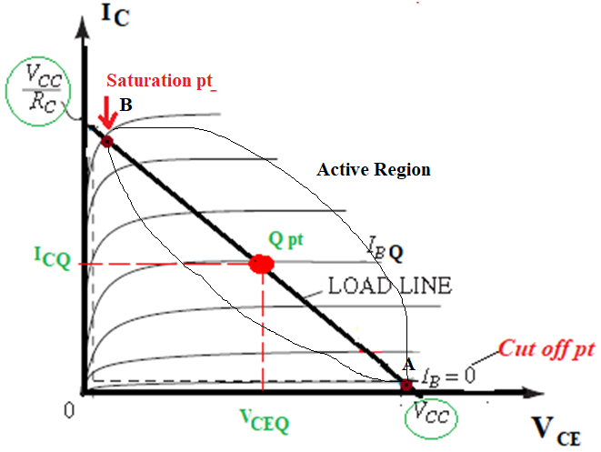

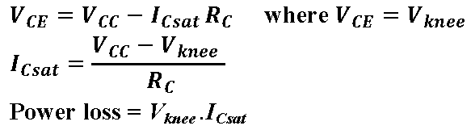
Switching Action of a BJT
A transistor which is used as a switch is known as a switching transistor.
i. OFF Region or cut off region
ii. ON Region or Saturation Region
iii. Active Region
Figure 1: Output characteristics. Of npn transistor.

Slide 4
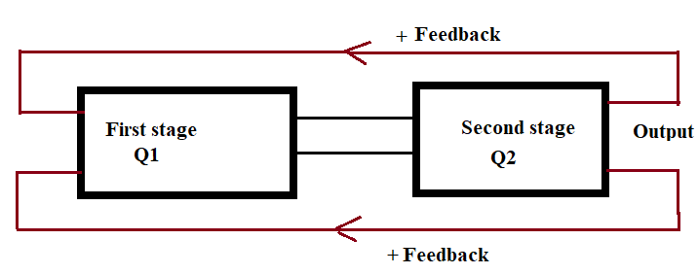
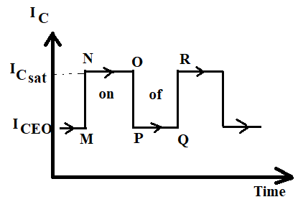
Multivibrator
A electronic circuit that generates square waves or other non-sinusoidal
such as rectangular ,saw-tooth waves is known as a Multivibrator.
Figure 2: Block diagram of multivibrator.
Figure 3:Waveform of Output current.

Slide 5
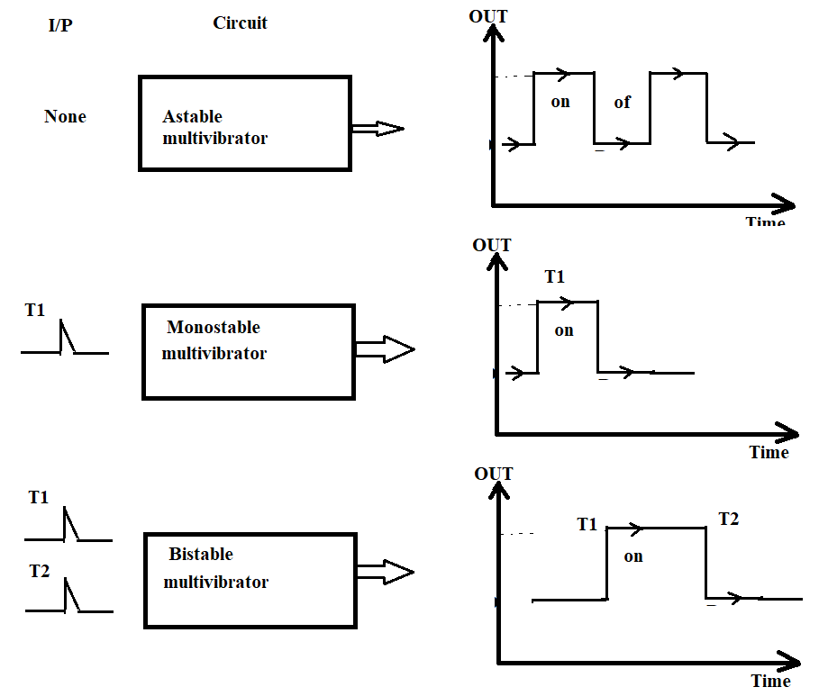
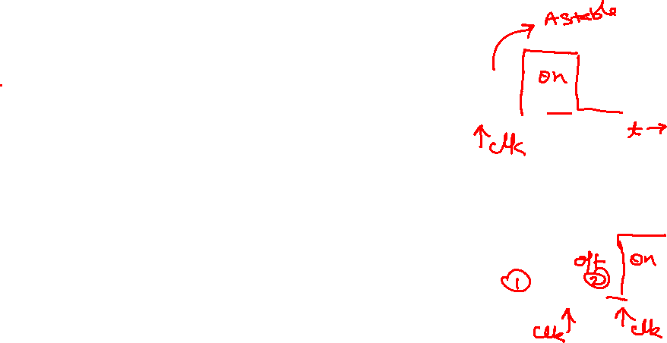
Types of Multivibrator
State | On | OF
First state | Q1 | Q2
Second state | Q2 | Q1
Astable or free running multivibrator
Monostable or one-shot multivibrator
Bi-stable or flip flop multivibrator
Figure 4: Input output relation of different types of multivibrator.

Slide 6
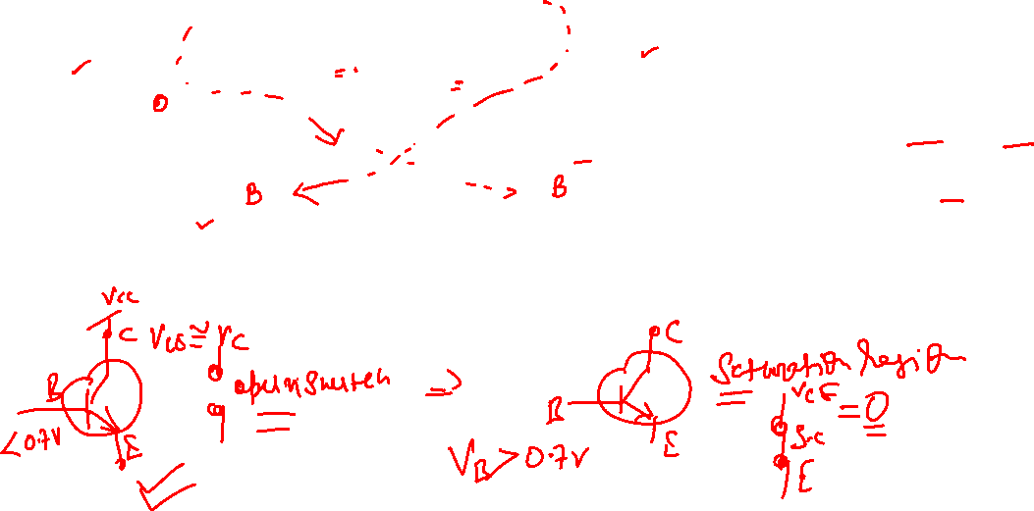

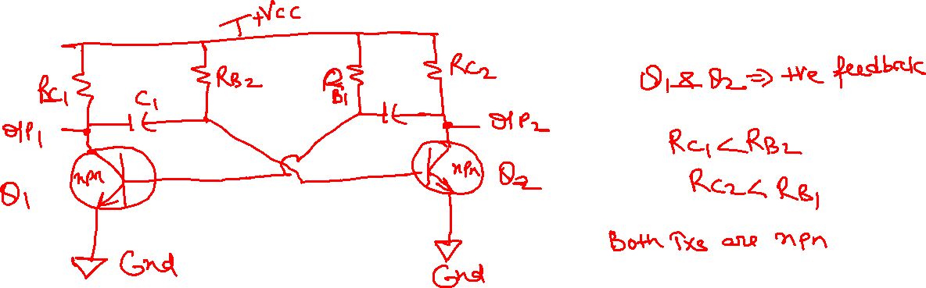
Astable Multivibrator
: A multivibrator which generates square waves of its own is called
as an astable or free running multivibrator.
Circuit Details:
Figure 5: Astable multivibrator.

Slide 7
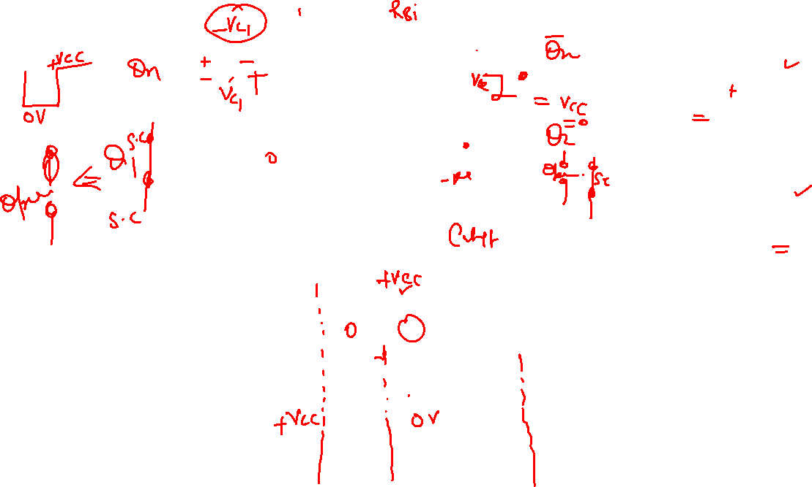

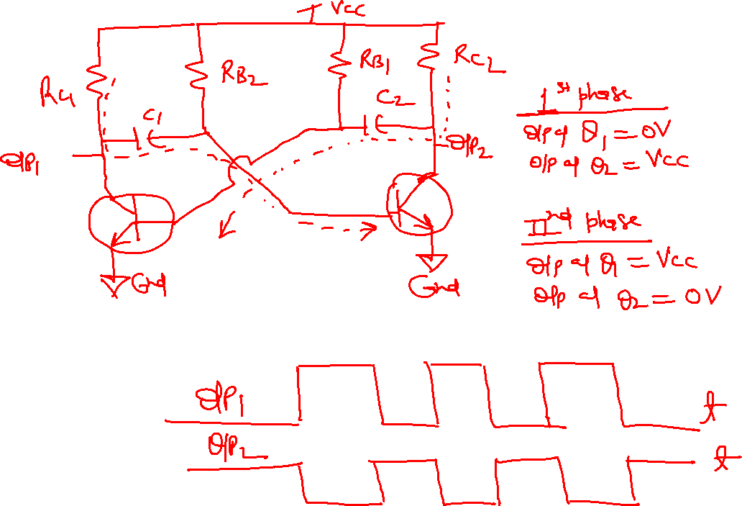
Operation

Slide 8
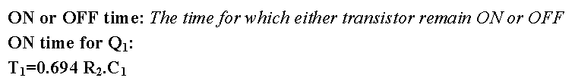
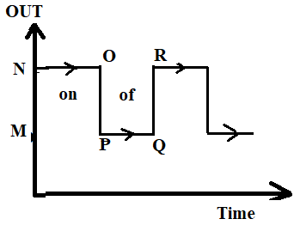
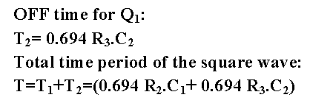

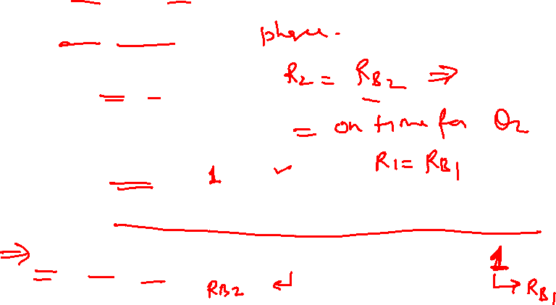
Figure 5:Output waveform.

Slide 9
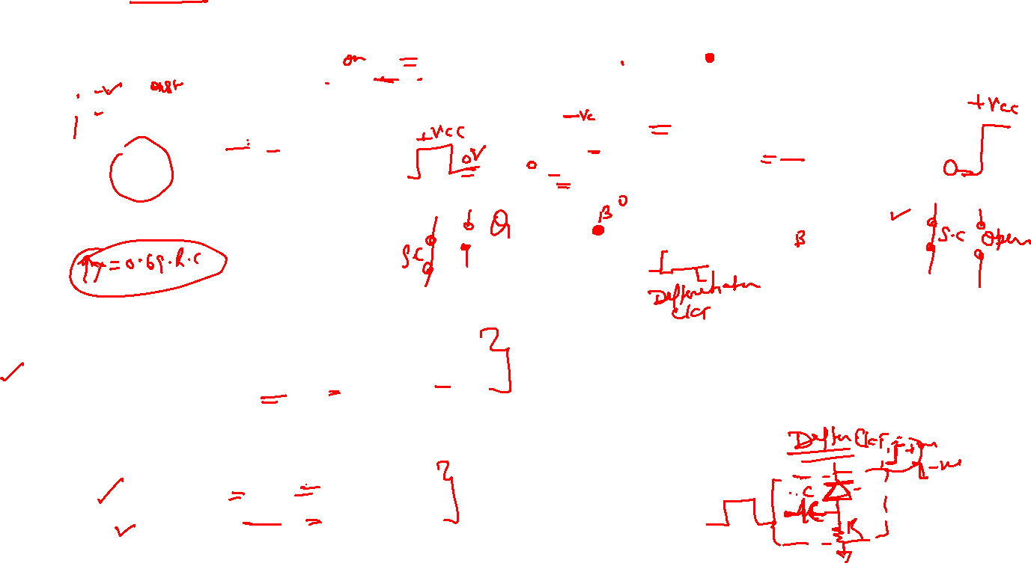
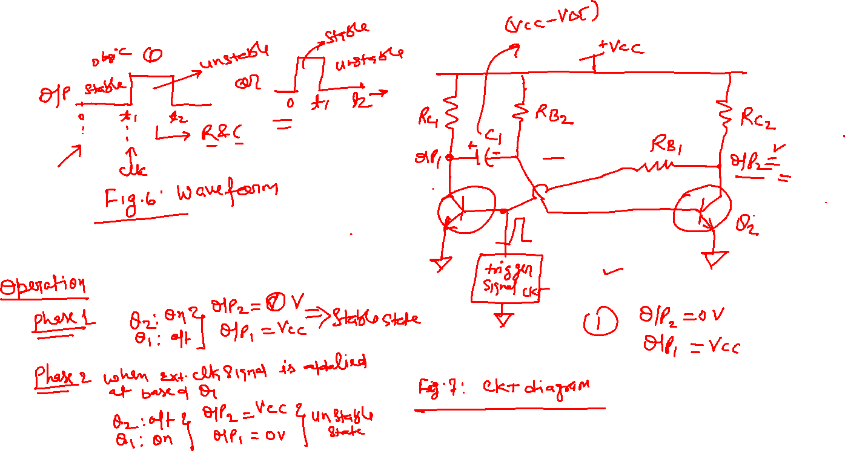
Monostable or one-shot multivibrator

Slide 10

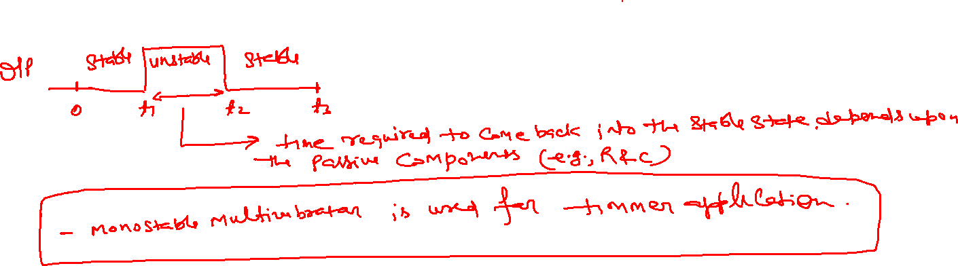

Slide 11
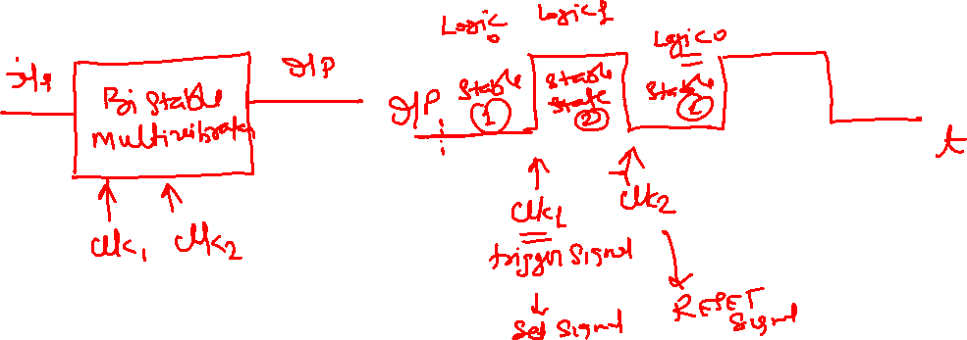
Bi-stable or flip flop multivibrator

Slide 12
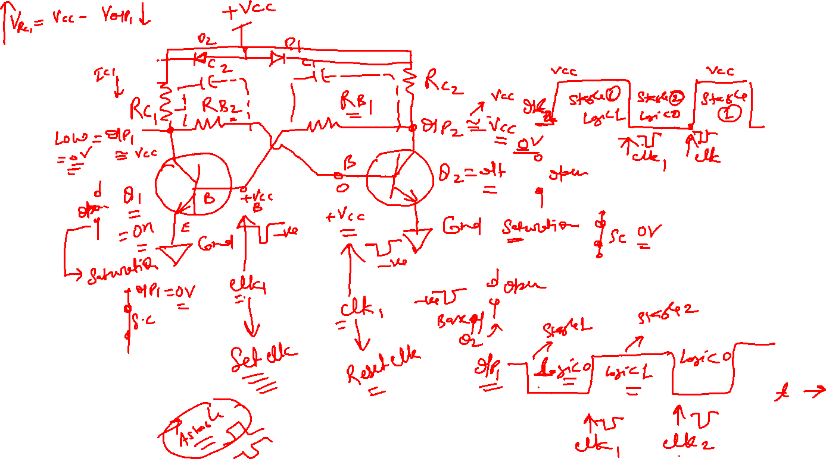

Slide 13

Comparison:
S.No. | Astable Multivibrator | Monostable Multivibrator | Bistable Multivibrator
1. | No stable states of output | Only one stable state of output | There are two stable states of output
2. | Trigger input is not required | One trigger input is required for changing the state of output | Two trigger inputs are required for changing the state of output
3. | Used as rectangular, square wave or ramp generator | Used as timer | Used as flip flop
4. | Number of quasi stable state is two | Number of quasi stable state is one | No quasi stable state

Slide 14
Thank You

